Slide 1
An Efficient
Client Onboarding
Solution
Presented by Team 4
Presenters:
Shwe Sin Oo (U1911031L)
Janzy Chua Pei Lin (U1910545K)
Brandon Chen Yun Xin (U1920186J)
Jerry Lee Rui (U1910048J)
Joelle Lee Shi Yau (U1810858J)

Slide 2
TABLE OF CONTENTS
01
04
02
05
03
06
Business Problem
Model Building
White Rock & Intermediaries
Inefficient client onboarding
Logistics & CART
Causes & Impacts
Limitations
Of Inefficient client onboarding
Here you could describe the topic of the section
Overview of Solution
Conclusion
Approach
DataSet
Data Insights
Here you could describe the topic of the section
Notes:
Business Problem, Causes & Impact - Shwe Sin
Overview of solution - janzy
Logistics - Brandon, regression - jerry
Limitations - joelle

Slide 3
Business Problem
Shwe Sin

Slide 4



White Rock and intermediary banks
Shwe Sin
Many banks adopt the “open architecture system”
Recommends asset management products from external institutions such as White Rock to customers
Banks serve as intermediary marketing channels for White Rock
Customers
Banks
White Rock

Slide 5
White Rock’s Global Presence
Shwe Sin
Goal of White Rocks:
To expand customer base across countries.
Improve efficiency and accuracy of processes
Asia
America

Slide 6
Recent trends
Shwe Sin
Increase in investment
Growing financial literacy
Rise of financial technology
Brokers and experts said there was an increase in the number of people trading and investing in the first half of this year
More than half of the households in the US have some investments in the stock market
Ease of access to financial services through technology has set at trend in the finance industry

Slide 7


Creating an efficient client onboarding process
Shwe Sin
What is client onboarding?
Process through which a client begins his journey with an institution.
Generally consists of multiple activities such as:
Evaluation of customer’s requirements
Fulfilment of legal obligations
Account opening
Notes:
Client onboarding can be simply defined as the entire process through which a user starts his journey as a customer or a client of a bank/ financial institution.Generally, the customer onboarding process constitutes of multiple activities. It begins with the evaluation of customer’s requirement which is followed by due-diligence, the fulfilment of legal aspects, opening the account, and making it operational.

Slide 8

Inefficiencies of the current client onboarding process
01
02
03
Shwe Sin
Multiple touchpoints
Customer contacted up to 10 time on average during the onboarding process
Requires many documents
Customers can be asked to submit up to 100 documents
Long duration
Process can take anywhere from 2 to 34 weeks

Slide 9
Causes of inefficiencies
Causes
Shwe Sin
Inter-departmental
communication
Manual process
Legacy systems
Piles of paperwork
Overnight mailings
Redundant data request
Still used by many financial institutions
Lacks flexibility compared to modern technology due to long development and release cycles.
Department-in-charge differs with each process
Requires continuous coordination and communication
Notes:
Legacy systems - Many banking legacy systems have been running for more than 30 years with an estimated over £2 trillion passing through legacy banks every day. With so much money relying on these systems it is understandably risky and complex to change them. All changes run the risk of introducing defects and potential vulnerabilities, so many banks took a risk averse, if-it-ain’t-broke-don’t-fix-it approach.
Communication: Client onboarding needs to follow different processes across its departments such as credit, legal and operational. The tricky part is that every compliance officer (or compliance department) might have their own interpretation of regulations. Thus, they end up having their own process specific to their own department/entity within the bank. It also means if a bank has three different entities then they will have three different interpretation of regulations/processes. Moreover, customers are likely to get confused on why they need to provide the same information (many times duplicate) at several points of the process and to several different parties.
these systems are difficult to change, it becomes harder to be flexible as the Industry and technology advances. Modern technology companies are entirely built around the ability to deliver lots of small changes quickly. Legacy systems and the technologies that they are based on make this hard; they are usually based on older ways of working that have long development and release cycles.

Slide 10
Impact of inefficient onboarding process
Shwe Sin
Loss of potential customers
Seeking for alternatives
35% of customers will recount bad experiences to friends
40% of consumers have switched banks during onboarding
First impression formed:
Loss of customer
Cumbersome. Outdated.
Time consuming.
Lost of potential revenue as average banking customer lifetime value is $45,600
Notes:
According to research by Deloitte, a whopping 40% of consumers have abandoned a bank onboarding process. When asked, the most common culprit cited was overly time-consuming paperwork and too many personal questions asked.

Slide 11
Overview of Solution
Janzy

Slide 12
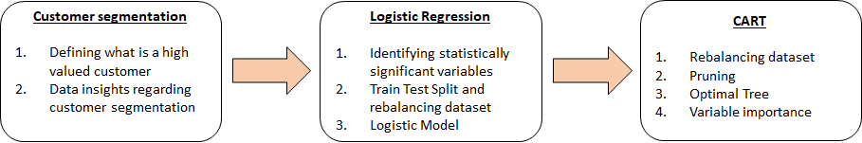
Overview of approach
Janzy

Slide 13
Dataset
Janzy
Belongs to 1 of the intermediary banks of White Rock
Variables:
CreditScore | Geography | Gender
Age | Tenure | Number of Products
Balance | HasCrCard (have a credit card) | IsActiveMember (Active Member of the bank)
EstimatedSalary

Slide 14
Customer segmentation
Janzy
Customers
High Value Customers
Low Value Customers
Criteria:
Number of products with the banks more than 1
Has a credit card with the bank
An active member with the bank
Remaining customers who did not fulfill all 3 criterias to be classified as ‘High Value’ Customers

Slide 15
3 criterias to become a high value customer
Janzy
Number of products more than 1
Has a credit card with the bank
Is Active Member of
the bank
Customers purchasing additional products from the bank
Greater revenue through multiple ways - interest, and fees
Indicator of profitability in the long run

Slide 16
Explanation of Dataset - independent variables
Janzy
Variables:
CreditScore | Geography | Gender
Age | Tenure | Balance
Number of Products | HasCrCard (have a credit card) | IsActiveMember (Active Member of the bank)
EstimatedSalary | CustomerValue
CreditScore | Geography | Gender
Age | Tenure | Number of Products
Balance | HasCrCard (have a credit card) | IsActiveMember (Active Member of the bank)
EstimatedSalary | CustomerValue
Tenure and Balance are not used because they are not known during the customer onboarding session

Slide 17
Explanation of Dataset - independent variables
Janzy
Age Middle aged customers tend to be more profitable Knowing age distribution can help banks to determine the variety of products suited for the age group | Gender Women are more likely to remain loyal to the bank Men are more likely to switch ( Deloitte, 2019)
Credit Rating (score) Indicator of risk Higher credit score, higher creditworthiness of the individual Easier to cross sell the products to customers | Estimated Salary Direct influence with customer purchasing behavior Higher salary, more likely to buy more investment products

Slide 18
Data Cleaning
Janzy
Check missing value, renaming categorical values
Adding CustomerValue to dataset
Factor the categorical variables
No missing data is found
Customer segmentation
To prepare the data for the model used

Slide 19
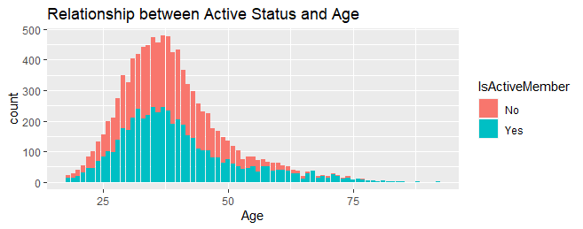
Data Insights
Janzy
About the same number of active and inactive members of the bank
Less active members in the older generation
Most customers come from the aged range 30 - 40 years old

Slide 20
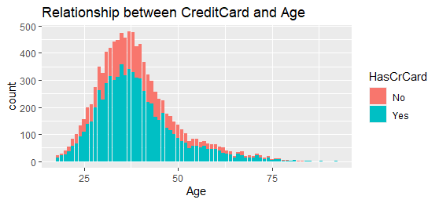
Data Insights
Janzy
Less customers from the younger generation
Most customers come from the aged range 30 - 40 years old

Slide 21
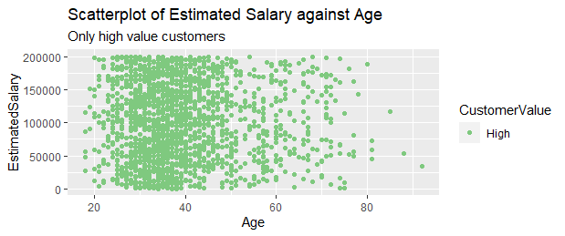
Data Insights
Janzy
Clustered at 30-40 years old

Slide 22
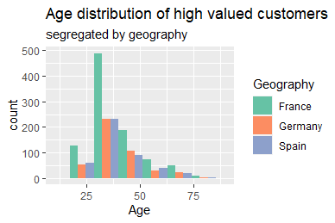
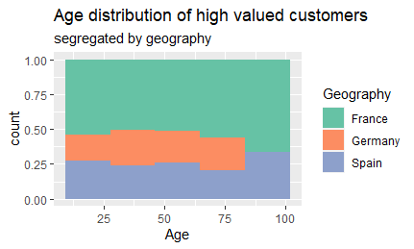
Data Insights
Janzy

Slide 23
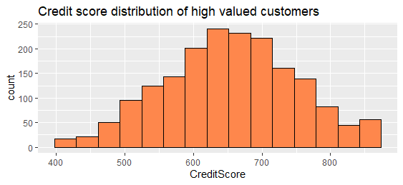
Data Insights
Janzy
Substantial amount of high value customers below 600

Slide 24
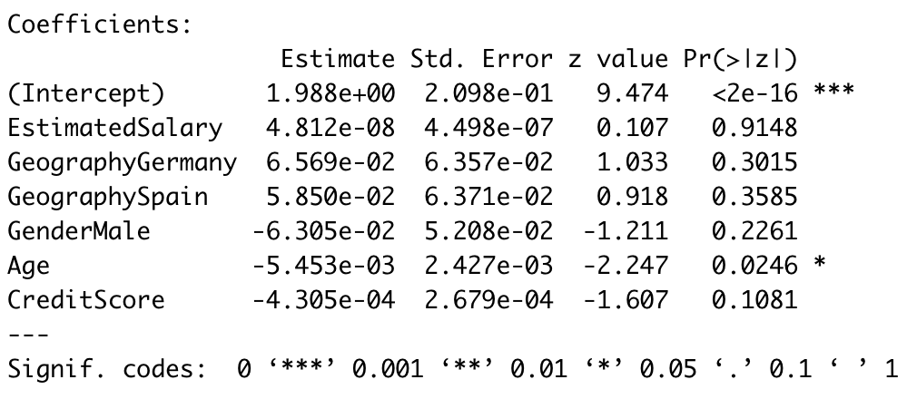
Logistic Regression: Initial Analysis
Brandon
Z = Intercept + C1(Salary) + C2(Geog=Germany) + C3(Geog=Spain) + C4(Gender=Male) + C5(Age) + C6(Credit Score)
Z = Intercept + C5(Age)
Notes:
Z is the logistic function to combine all the independent variables into one value.
Baseline: Geography = France, Gender = Female
Briefly explain P-value

Slide 25
Logistic Regression: Process Flow
Brandon
1
Train Test Split
2
Rebalance
3
Predict
1
2

Slide 26
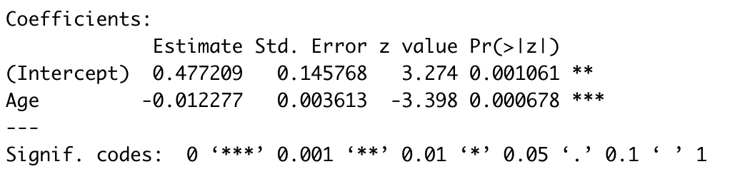
Logistic Regression: Subsequent Analysis
Brandon
Z = 0.4772 - 0.0122*(Age)
An increase in a customer’s age by an additional year will decrease the odds of them being ‘high’ value by a factor of e^0.0122 = 1.012

Slide 27
Logistic Regression: Model Predictions
Brandon
Cust Value | ‘High’ (Predicted) | ‘Low’ (Predicted)
‘High’ (Actual) | 324 | 226
‘Low’ (Actual) | 1330 | 1120
Overall Accuracy = 49.5%
Sensitivity = 324 / (324+226)
= 59%
Notes:
Sensitivity measures the correctly predicted ‘High’ values i.e. true positive rate

Slide 28
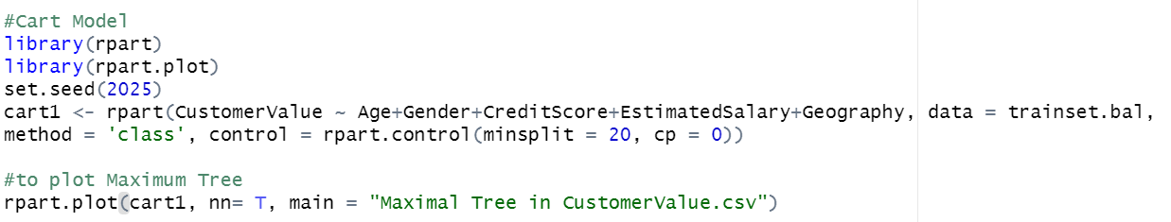
CART: Growing the Tree
Jerry
The CART model is first allowed to grow till its maximum depth with the objective of reducing the misclassification error at each node as shown below

Slide 29
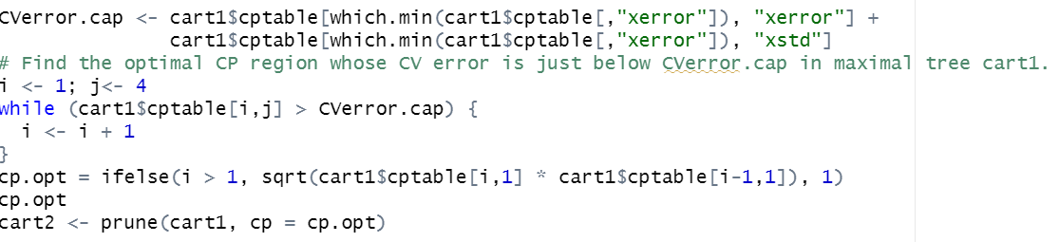
CART: Pruning
Jerry
An Increase in size of the tree also increases the likelihood of overfitting error. Thus, pruning is required to reduce the size of decision trees by removing sections of the tree.

Slide 30
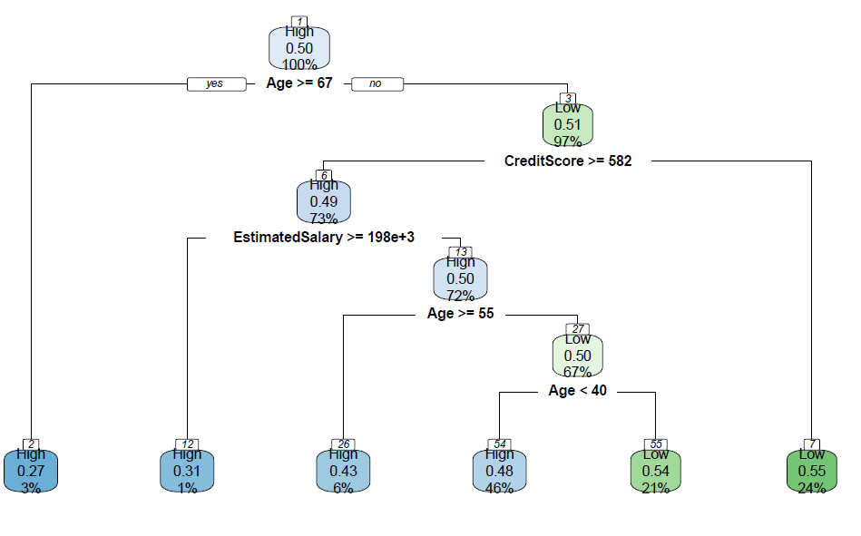
CART: Predicted Result
Jerry
The optimal tree after pruning is show below
Generally, this model result is easy to read and White Rock can make use of this model to quickly classify and identify a customer’s value during the onboarding process.
Notes:
A condition for each split is presented under parent nodes. Observations that meet the condition (i.e., when the condition yields an answer of “yes”) go to the child node on the left, otherwise go to the child node on the right.
For the first split, the decision rule is whether age is greater or equal to 67. 3% of the customers who satisfied the decision rule are placed in the left child node 2 and they have a 27% chance of being a high valued customer. 97% of the customers who do not satisfy the rule are placed in the right child node 3 and they have a 51% chance of being a low valued customer.We are able to conclude that a customer’s value is likely to be high when his age is greater or equal to 65. This agrees with our intuition that when a person is older, they naturally have more savings in their bank account.
The 2nd split occurs at the 3rd node where the decision rule is whether a customer’s credit score is greater or equal to 582. 73% of the customers in node 3 who satisfied the rule are placed in the left child node 6 and they have 49% chance of being a high valued customer. 24% of the customers in node 3 who do not satisfy the rule are placed on the right node 7 and they have a 55% chance of being a low valued customer. It allows us to gather that a customer’s value is likely to be high when his credit score is greater than 582. Credit Score is an important variable as it reflects the reliability of a customer.Therefore, a higher credit score is usually linked to a higher customer value since they will have a lower risk assessment.

Slide 31
CART: Model Analysis
Jerry
In order to compare the predicted values with the actual values of the dataset ,we compute a confusion matrix as seen below
Cust Value | ‘High’ (Predicted) | ‘Low’ (Predicted)
‘High’ (Actual) | 1081 | 751
‘Low’ (Actual) | 940 | 892
As seen from the confusion matrix, the sensitivity (true positive rate) can be calculated to be 1081/(1081+751) = 0.60 while the specificity (true negative rate) is 892/(892+940) = 0.486.
Notes:
As seen from the confusion matrix, the sensitivity (true positive rate) can be calculated to be 1081/(1081+751) = 0.60 while the specificity (true negative rate) is 892/(892+940) = 0.486. This means that when the actual value was ‘high’, the model predicted 60% correctly whereas when the actual value was ‘low’, 48.6% was predicted correctly.
The overall accuracy obtained for the model is 0.538 which translates to 54%. While the accuracy is not very high, there is a slight improvement from the logistic regression model which suggests a better fit at predicting a customer’s value from the chosen dataset. Ultimately, the poor accuracy might be due to various factors such as imperfect information based solely on the chosen dataset. The limitations of the models will be further discussed in the section below.

Slide 32
CART:Variable Importance
Jerry
Variable importance assesses the magnitude of the impact of an independent variable on a customer’s value.
As seen from the table below, ‘Age’, ‘Credit Score’ and ‘Estimated Salary’ of a customer have the largest impact on their value. Amongst these factors, ‘Age’ has the highest importance in determining a customer’s value.
 | Age | Credit Score | Estimated Salary
Variable Importance | 16.069062 | 3.662301 | 2.287246
Proportion | 72% | 16% | 12%

Slide 33
Comparison of CART & Logistic
Jerry
Model Type | Logistics Regression | CART
Advantages | Easily identifies variables that might have a linear association with the Customer’s value. | Does not require manual train test split since 10-fold cross validation is automatically carried out. Does not require backwards elimination to identify significant variables. Able to provide better predictions for data which is not linearly separable such as ours. Variables are identified and ranked by importance.
Disadvantages | Unable to handle data which is non-linearly separable. Does not handle skewed dataset well which necessitates rebalancing of dataset. | Requires pruning to reduce risk of overfitting.

Slide 34
Limitations
Joelle

Slide 35
Limitations
01
Joelle
Segmentation of Customer
Transactions of customer over time
‘‘The present value of the future profit stream expected over a given time horizon of transacting with the customer’’ - Defined by Kotler
Current Limitation: Balance provided was captured at a point in time.

Slide 36
Limitations
01
Joelle
Segmentation of Customer
Type of Purchases
“Consumers globally hold an average of 7.4 banking products across all their various relationships”
Current Limitation: Maximum Product is 4

Slide 37
Limitations
01
Joelle
Segmentation of Customer
Type of Purchases
According to one of the literature research (Fader et al. ,2005):
Past customer recency, frequency and monetary to determine customer value with high accuracy

Slide 38
Limitations
02
Joelle
Model was built upon data from 3 countries of a bank
“White Rock currently has 32 markets globally, including 8 in Asia. They are working with intermediaries who distribute their investment products.”
Current Limitation: Dataset from a bank based in France, Germany and Spain

Slide 39
Limitations
03
Joelle
Predictors of Customer Value
The common variables:
Lifestyle characteristics of the customer (Haenlein et al., 2007)
Macroeconomic environment & competition determine the activity level in the industry (Gupta et al., 2006)
Customer's brand-switching behaviour (Gupta et al., 2006)

Slide 40
Conclusion
Joelle
Address current prevalent issues on inefficient client on boarding
Further improvement of model
Need for White Rock and intermediaries to mitigate huge potential loss in inefficient client onboarding

Slide 41
THANKS
Do you have any questions?

